Slide 1
INTRODUCTIOn TO SOCIOLOGY 2E
Chapter 1 AN INTRODUCTION TO SOCIOLOGY
PowerPoint Image Slideshow

Slide 2
Figure 1.1
Sociologists study how society affects people and how people affect society. (Photo courtesy of Diego Torres Silvestre/flickr)

Slide 3
Figure 1.2
Sociologists learn about society as a whole while studying one-to-one and group interactions. (Photo courtesy of Gareth Williams/flickr)

Slide 4
Figure 1.3
Modern U.S. families may be very different in structure from what was historically typical. (Photo courtesy of Tony Alter/Wikimedia Commons)

Slide 5
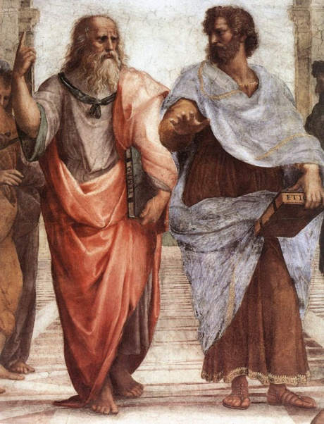
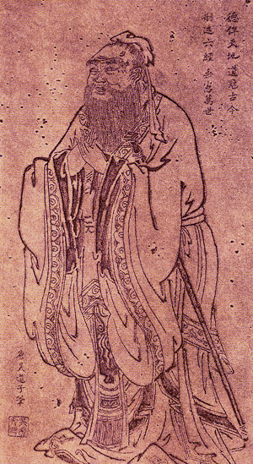
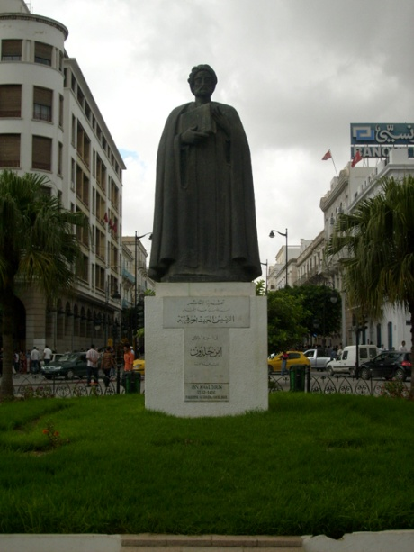
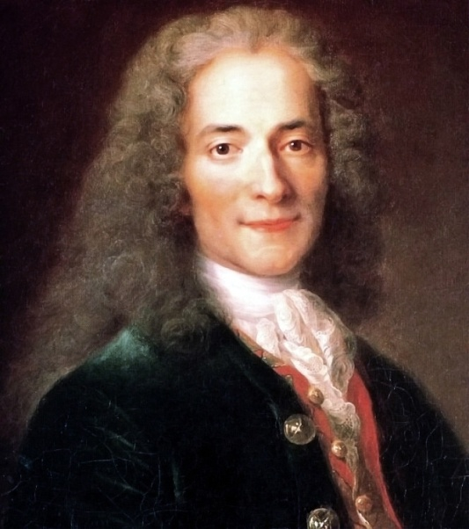
Figure 1.4
People have been thinking like sociologists long before sociology became a separate academic discipline: Plato and Aristotle, Confucius, Khaldun, and Voltaire all set the stage for modern sociology. (Photos (a),(b),(d) courtesy of Wikimedia Commons; Photo (c) courtesy of Moumou82/Wikimedia Commons)

Slide 6
Figure 1.5
Auguste Comte is considered by many to be the father of sociology. (Photo courtesy of Wikimedia Commons)

Slide 7
Figure 1.6
Karl Marx was one of the founders of sociology. His ideas about social conflict are still relevant today. (Photo courtesy of John Mayall/Wikimedia Commons)

Slide 8
Figure 1.7
Sociologists develop theories to explain social occurrences such as protest rallies. (Photo courtesy of voanews.com/Wikimedia Commons)

Slide 9
Figure 1.8
Some sociologists see the online world contributing to the creation of an emerging global culture. Are you a part of any global communities? (Photo courtesy of quasireversible/flickr)

Slide 10
Figure 1.9
The research of sociologists Kenneth and Mamie Clark helped the Supreme Court decide to end “separate but equal” racial segregation in schools in the United States. (Photo courtesy of public domain)

